Slide 1

ECEN 361
Real-Time and Embedded Systems
Lecture 3 – Interfaces

Slide 2
Accessing the Processor
We need to get information in/out of our system
Some of that information is Digital – On/off
Some of that information is Analog – A continuous signal
Both of these might come synchronously or asynchronously
Some of that information comes in the form of Standard Communications Busses
UART
I2C/SPI
USB
Bluetooth/WIFI

Slide 3
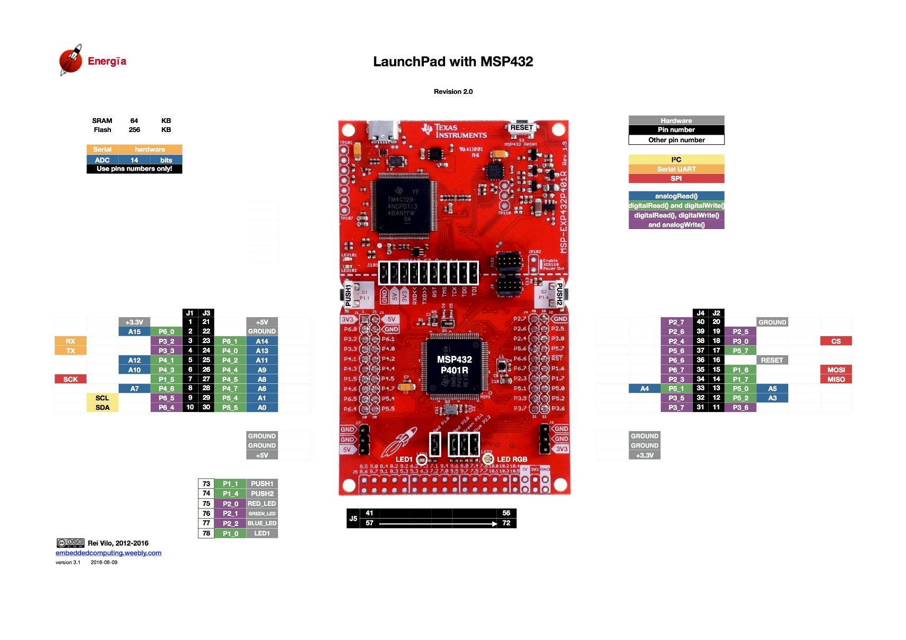
Notes:
Look up analog ref

Slide 4
Digital I/O
These signals are either On or Off – Or are they?
What does On mean?
Voltage – 5 Volts? 3.3 Volts? 1.8 Volts?
Current – How much current?

Slide 5
Digital I/O Output
These signals are either On or Off – Or are they?
Voltage – 3.3 Volts
Current limit – 6/20 mAmps – Is this enough?
Damage on a short circuit?

Slide 6
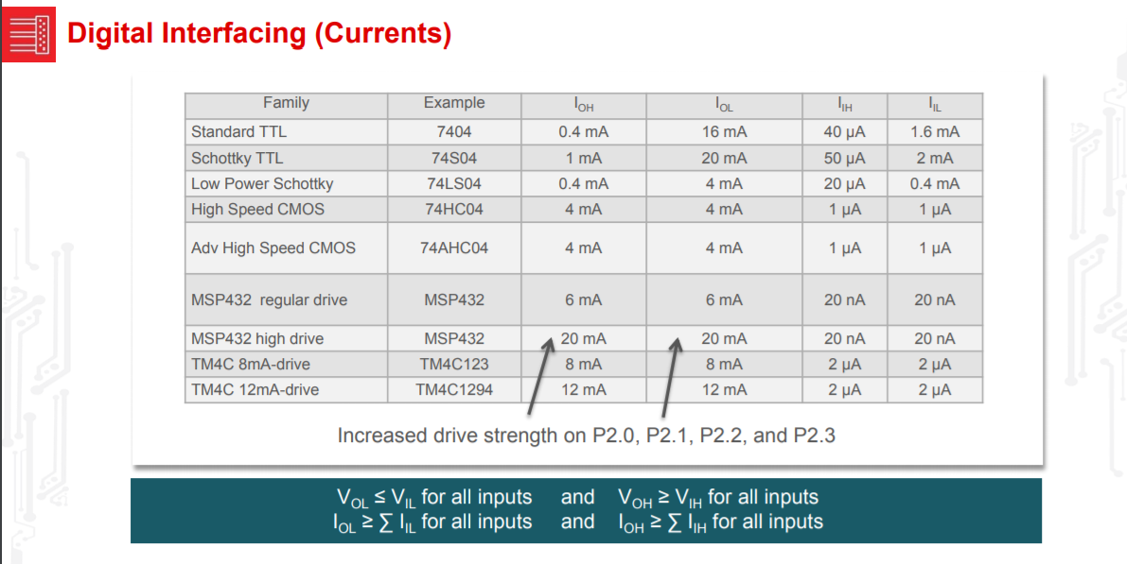
Digital I/O Output

Slide 7
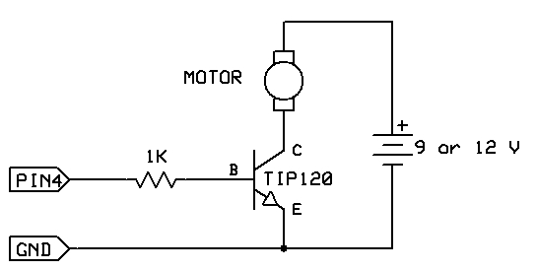
Digital I/O Output
What if this is not enough?

Slide 8
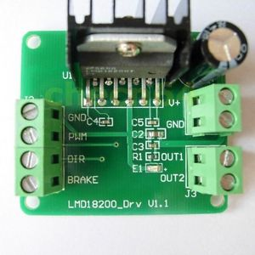
Digital I/O Output

Slide 9
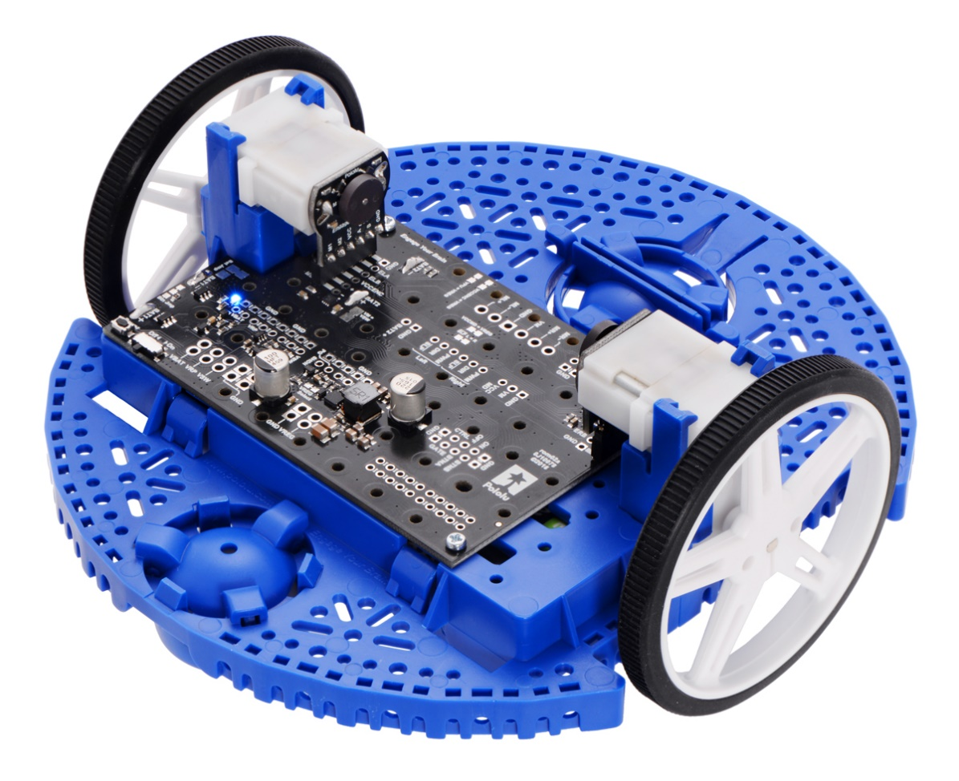
Digital I/O Output

Slide 10
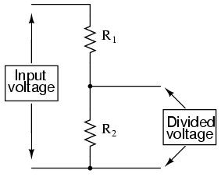
Digital I/O Output
What if we need 3.3 Volts and are given 5?
What if we need 5 Volts and are give 3.3?

Slide 11
Digital I/O Input
What is the input voltage?
What if we need 3.3 Volts and are given 5?
What if we need 5 Volts and are give 3.3?
On the MSP432 – 5 Volts input will damage the part!

Slide 12
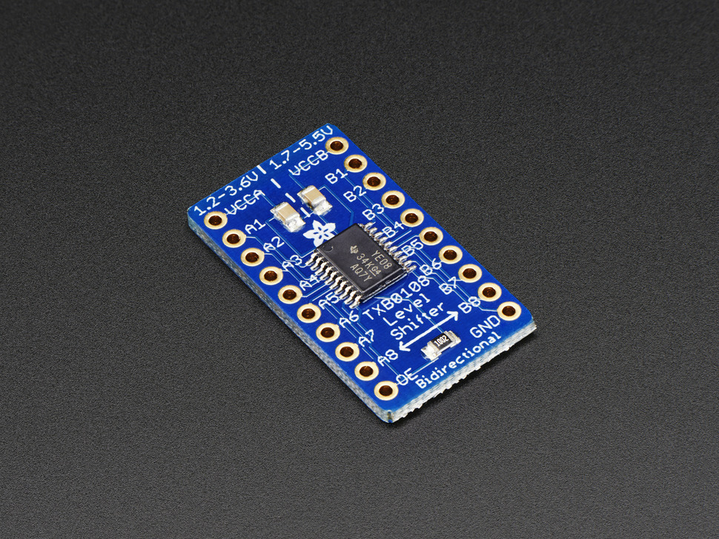
Digital I/O Output
What if we need 3.3 Volts and are given 5?
What if we need 5 Volts and are give 3.3?

Slide 13
Digital I/O Output
From the Software perspective we can either use a low level or a high level driver to configure and access the hardware.

Slide 14
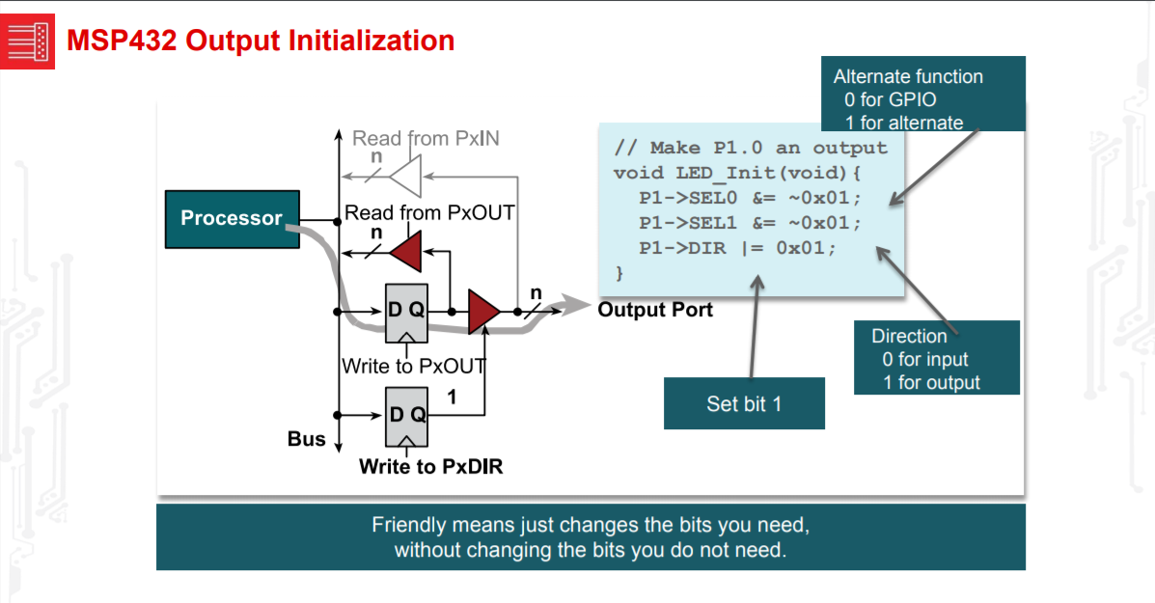
Digital I/O Output

Slide 15
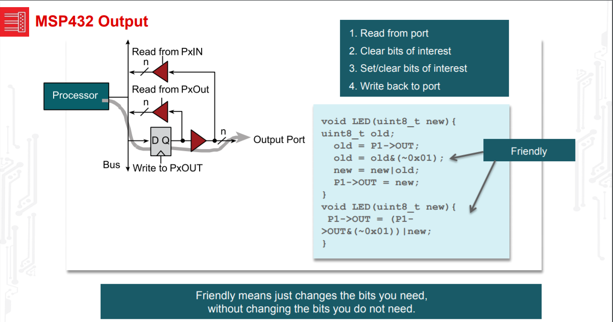
Digital I/O Output

Slide 16
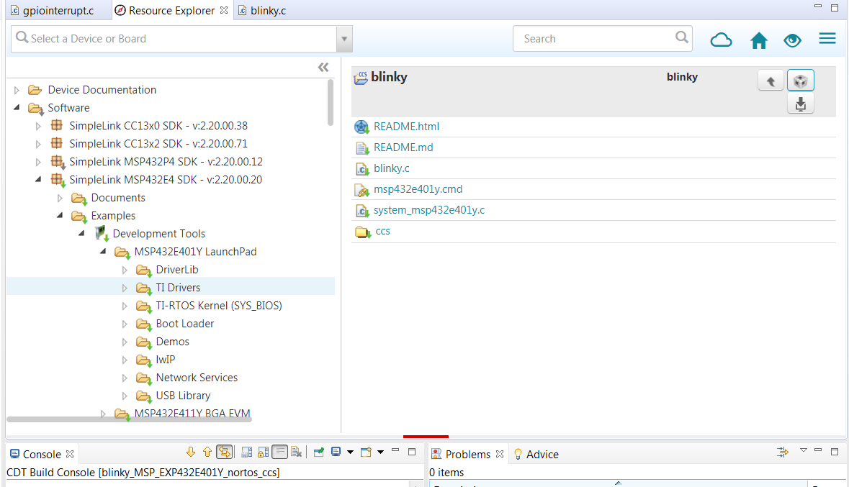
Digital I/O Output

Slide 17
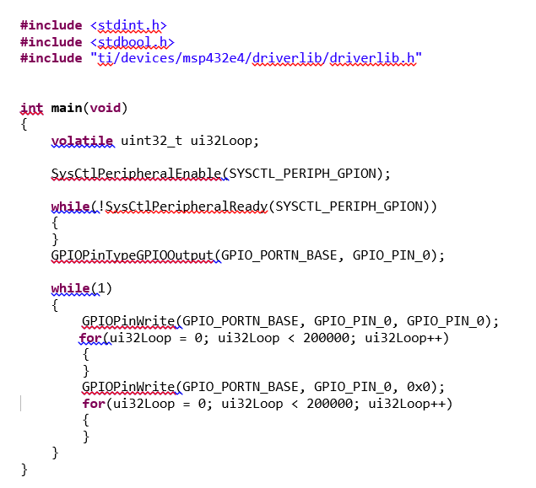
Digital I/O Output

Slide 18
Digital I/O Input
Is the input synchronous or asynchronous?
Synchronous – We will read a value at a specific time in the program.
Asynchronous – We can either poll or use an interrupt.

Slide 19
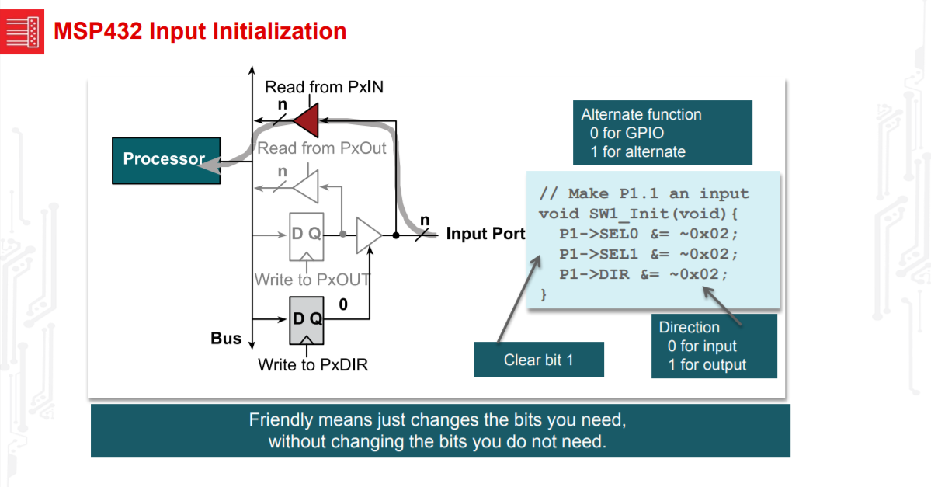
Digital I/O Input - Synchronous

Slide 20
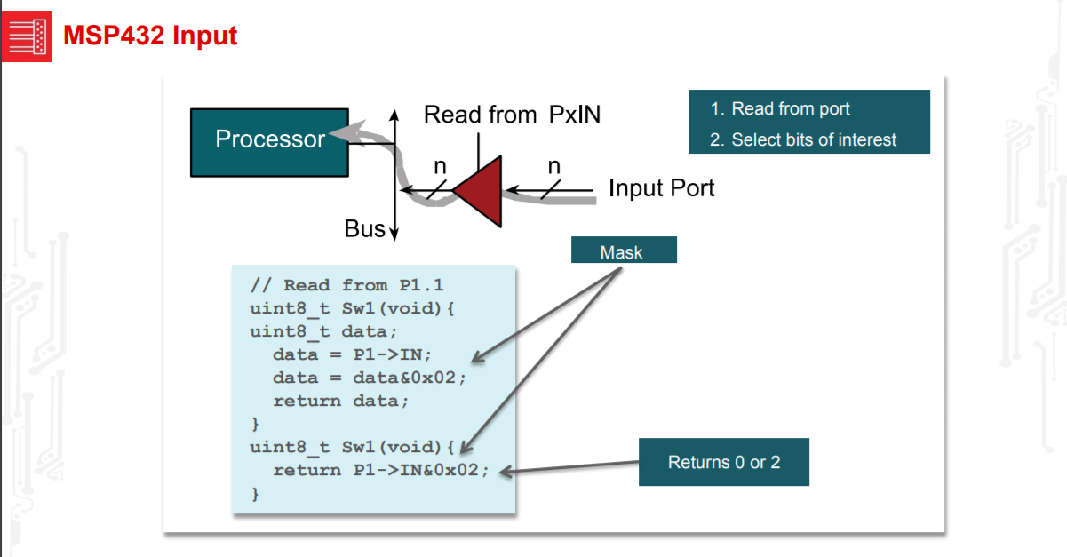
Digital I/O Input - Synchronous

Slide 21
Digital I/O Input - Synchronous
GPIOPinTypeGPIOInput(GPIO_PORTA_BASE, GPIO_PIN_2); GPIOPinTypeGPIOInput(GPIO_PORTA_BASE, GPIO_PIN_3);

Slide 22
Digital I/O Input – Asynchronous using Polling
Asynchronous – Using a Polling loop
#include <msp430.h>
int main(void)
{
WDTCTL = WDTPW + WDTHOLD;
// Stop watchdog timer
P1DIR |= 0x01;
// Set P1.0 to output direction
while (1)
// Test P1.3
{
if ((BIT3 & P1IN))
P1OUT |= 0x01;
// if P1.3 set, set P1.0
else
P1OUT &= ~0x01;
// else reset
}
}

Slide 23
Digital I/O Input – Asynchronous using Interrupts
int main(void)
{
Board_initGeneral();
Board_initGPIO();
Board_initUART();
GPIO_write(Board_LED0, Board_LED_ON);
System_printf("Starting the GPIO Interrupt example\nSystem provider is set"
" to SysMin. Halt the target to view any SysMin contents in"
" ROV.\n");
System_flush();
/* install Button callback */
GPIO_setCallback(Board_BUTTON0, gpioButtonFxn0);
/* Enable interrupts */
GPIO_enableInt(Board_BUTTON0);
if (Board_BUTTON0 != Board_BUTTON1) {
/* install Button callback */
GPIO_setCallback(Board_BUTTON1, gpioButtonFxn1);
GPIO_enableInt(Board_BUTTON1);
}
/* Start BIOS */
BIOS_start();
return (0);
}

Slide 24
Digital I/O - Standard Communications Busses
Some information comes in the form of Standard Communications Busses
UART
I2C
USB
Wifi/Bluetooth

Slide 25
Digital I/O - Data Transmission Tree
Data Transmission
Parallel
Serial
Synchronous
Asynchronous

Slide 26
Digital I/O - Parallel
Data is sent and received more than one bit at a time
Transmission on multiple wires

Slide 27
Digital I/O - Parallel
Many lines of communication, synchronized bursts of data
Transmitter
Receiver
Time

Slide 28
Endianness, how it relates to communication
Big Endian- MSB first, less significant bytes in descending order
Little Endian- MSB last, data in ascending order
Endian type determines how the data is interpreted, and how it should be sent in both serial and parallel communication.

Slide 29
Digital I/O - Serial
Data is sent and received one bit at a time
Transmission on single wire*

Slide 30
Digital I/O - Serial Communication
One line of communication, long string of data
Signal
Time

Slide 31
Digital I/O - Why Serial?
Fewer wires translates to
Lower cost
Simpler set-up

Slide 32
Digital I/O – Synchronous Serial
Sender and receiver have their clocks synchronized
Transmissions occur at specified intervals
Advantage – Faster

Slide 33
Digital I/O – Serial Asynchronous
Devices are not synchronized
Transmissions happen at unpredicted intervals
Advantages
Simpler
More robust

Slide 34
Digital I/O
Both synchronous and asynchronous must have agreed upon bit transfer rate

Slide 35
Digital I/O - Why Asynchronous?
Disadvantage:
- Slower due to overhead
Advantages:
- Simpler
- Cheaper
- Information can be sent when ready

Slide 36
FYI Term: “UART”
Universal
Asynchronous
Receiver-
Transmitter
“…a computer component that handles asynchronous serial communication.”
www.webopedia.com

Slide 37
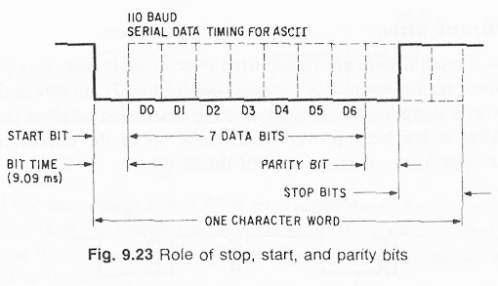
UART

Slide 38
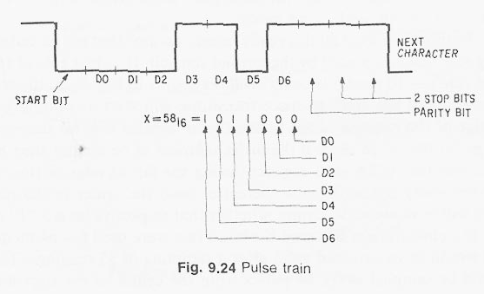
UART

Slide 39
Definitions
Start Bit
Signals the beginning of the data word
A low bit after a series of high bits
Data Bits
The meat of the transmission
Usually 7 or 8 bits

Slide 40
Definitions Continued
Parity Bit
An error check bit placed after the data bits
Can be high or low depending on whether odd parity or even parity is specified
Stop Bit/s
One or two high bits that signal the end or the data word
Data Word
Start Bit, Data Bits, Parity Bit, & Stop Bit/s

Slide 41
UART
BAUD RATE
BIT RATE

Slide 42
Baud Rate
Baud Rate = bits transferred/second
baud rate INCLUDES start, stop, and parity
“bit rate” refers to JUST data bits transferred per second (may include parity)
baud rate > bit rate

Slide 43
Baud Rate Example
Calculate baud rate
1/bit time = 1/9.09ms = 110 baud
Time to transmit word:
(11 bits) x (9.09ms) = 0.1 s
Word rate
1/0.1s = 10 char/s
Bit rate
(10 char/s) x (8 bits/char) = 80 bits/s

